Slide 1
CSE419 – Artificial Intelligence and Machine Learning 2020 PhD Furkan Gözükara, Toros University https://github.com/FurkanGozukara/CSE419-Artificial-Intelligence-and-Machine-Learning-2020
Lecture 4
Geometric View of Data
Based on Asst. Prof. Dr. David Kauchak (Pomona College) Lecture Slides
Source: https://cs.pomona.edu/~dkauchak/classes/f13/cs451-f13/lectures/

Slide 2

Proper Experimentation

Slide 3
Experimental setup
REAL WORLD USE OF ML ALGORITHMS
past
future
predict
learn
Training
Data
Testing
Data
(data with labels)
(data without labels)
How do we tell how well we’re doing?

Slide 4
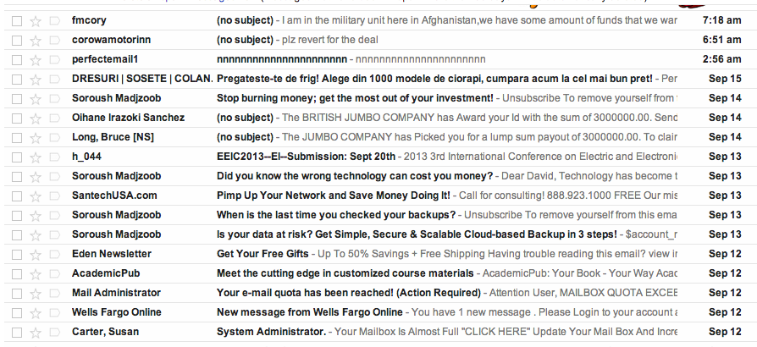
Real-world classification
Google has labeled training data, for example from people clicking the “spam” button, but when new messages come in, they’re not labeled

Slide 5
Classification evaluation
Data
Label
0
Use the labeled data we have already to create a test set with known labels!
Why can we do this?
0
Labeled data
1
1
0
Remember, we assume there’s an underlying distribution that generates both the training and test examples
1
0

Slide 6
Classification evaluation
Data
Label
Training data
0
0
1
Labeled data
1
0
1
Testing data
0

Slide 7
Classification evaluation
Data
Label
Training data
0
0
classifier
1
Labeled data
train a
classifier
1
0
1
Testing data
0

Slide 8
Classification evaluation
Data
Label
1
0
Pretend like we don’t know the labels

Slide 9
Classification evaluation
Data
Label
1
1
classifier
1
0
Pretend like we don’t know the labels
Classify

Slide 10
Classification evaluation
Data
Label
1
1
classifier
1
0
Pretend like we don’t know the labels
Classify
How could we score these for classification?
Compare predicted labels to actual labels

Slide 11
Test accuracy
To evaluate the model, compare the predicted labels to the actual labels
Accuracy: the proportion of examples where we correctly predicted the label
prediction
Label

Slide 12
Proper testing
Training
Data
learn
One way to do algorithm development
try out an algorithm
evaluated on test data
repeat until happy with results
Test
Data
Is this ok?
Evaluate model
No. Although we’re not explicitly looking at the examples, we’re still “cheating” by biasing our algorithm to the test data

Slide 13
Proper testing
Once you look at/use test data it is no longer test data!
Test
Data
Evaluate model
So, how can we evaluate our algorithm during development?

Slide 14

Development set
Training
Data
All Training
Data
Development
Data
Labeled
Data
Test
Data
(data with labels)

Slide 15
Proper testing
Training
Data
learn
Using the development data:
try out an algorithm
evaluated on development data
repeat until happy with results
When satisfied, evaluate on test data
Development
Data
Evaluate model

Slide 16
Proper testing
Training
Data
learn
Using the development data:
try out an algorithm
evaluated on development data
repeat until happy with results
Development
Data
Any problems with this?
Evaluate model

Slide 17
Overfitting to development data
Be careful not to overfit to the development data!
Training
Data
All Training
Data
Development
Data
Often we’ll split off development data this multiple times (in fact, on the fly), but you can still overfit, but this helps avoid it

Slide 18
ML grade here is overfitting because it perfectly fits the model for training set but not for future predictions
Terrain | Unicycle-type | Weather | Jacket | ML grade | Go-For-Ride?
Trail | Mountain | Rainy | Heavy | D | YES
Trail | Mountain | Sunny | Light | C- | YES
Road | Mountain | Snowy | Light | B | YES
Road | Mountain | Sunny | Heavy | A | YES
… | Mountain | … | … | … | YES
Trail | Normal | Snowy | Light | D+ | NO
Trail | Normal | Rainy | Heavy | B- | NO
Road | Normal | Snowy | Heavy | C+ | YES
Road | Normal | Sunny | Light | A- | NO
Trail | Normal | Sunny | Heavy | B+ | NO
Trail | Normal | Snowy | Light | F | NO
… | Normal | … | … | … | NO
Trail | Normal | Rainy | Light | C | YES

Slide 19
Pruning revisited
YES
Unicycle
Mountain
Normal
Unicycle
Mountain
Normal
YES
Terrain
Road
Trail
YES
NO
Weather
NO
Rainy
Sunny
Unicycle
Snowy
Mountain
Normal
NO
YES
NO
YES
Terrain
Road
Trail
Which should we pick?
YES
NO

Slide 20
Pruning revisited
YES
Unicycle
Mountain
Normal
Unicycle
Mountain
Normal
YES
Terrain
Road
Trail
YES
NO
Weather
NO
Rainy
Sunny
Unicycle
Snowy
Mountain
Normal
NO
YES
NO
YES
Terrain
Road
Trail
Use development data to decide!
YES
NO

Slide 21
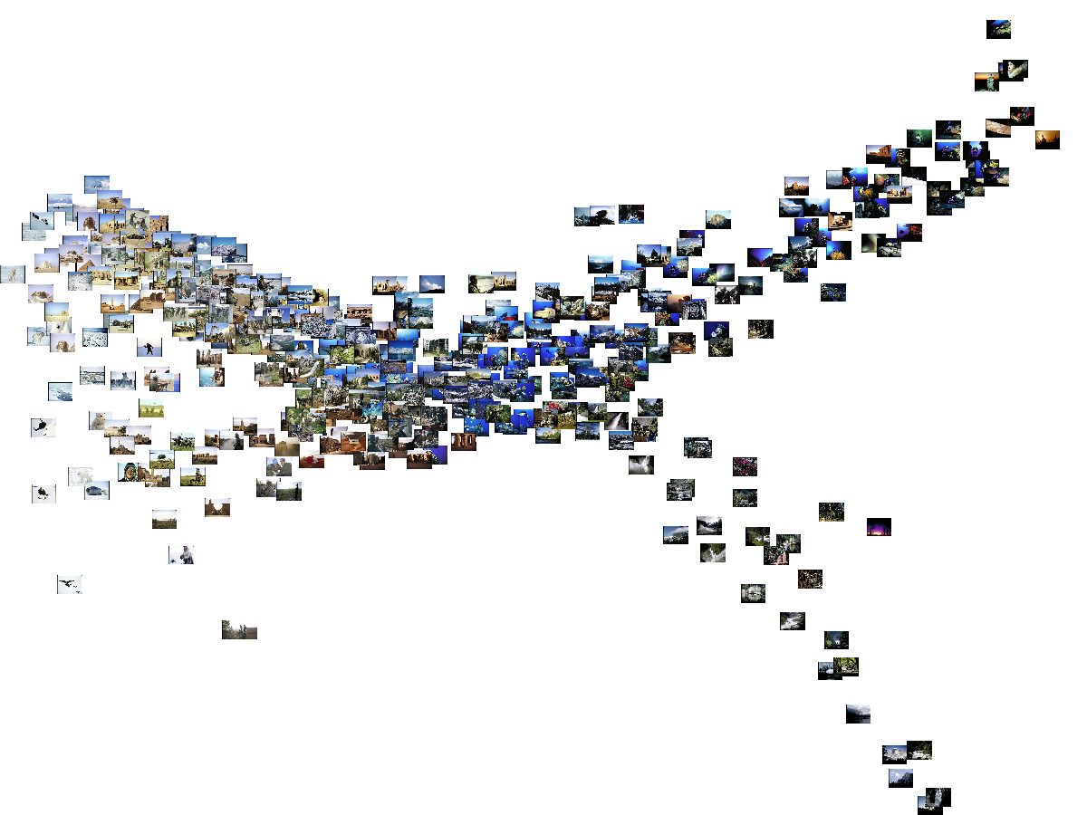
Machine Learning: A Geometric View

Slide 22
Apples vs. Bananas
Weight | Color | Label
4 | Red | Apple
5 | Yellow | Apple
6 | Yellow | Banana
3 | Red | Apple
7 | Yellow | Banana
8 | Yellow | Banana
6 | Yellow | Apple
Can we visualize this data?

Slide 23
Apples vs. Bananas
Turn features into numerical values
Weight | Color | Label
4 | 0 | Apple
5 | 1 | Apple
6 | 1 | Banana
3 | 0 | Apple
7 | 1 | Banana
8 | 1 | Banana
6 | 1 | Apple
1
A
B
B
B
A
Color
0
A
A
0
Weight
10
We can view examples as points in an n-dimensional space where n is the number of features

Slide 24
Examples in a feature space
feature₂
label 1
label 2
label 3
feature₁

Slide 25
Test example: what class?
feature₂
label 1
label 2
label 3
feature₁

Slide 26
Test example: what class?
feature₂
label 1
label 2
closest to red
label 3
feature₁

Slide 27
Another classification algorithm?
To classify an example d:
Label d with the label of the closest example to d in the training set

Slide 28
What about this example?
feature₂
label 1
label 2
label 3
feature₁

Slide 29
What about this example?
feature₂
label 1
label 2
closest to red, but…
label 3
feature₁

Slide 30
What about this example?
feature₂
label 1
Most of the next closest are blue
label 2
label 3
feature₁

Slide 31
k-Nearest Neighbor (k-NN)
To classify an example d:
Find k nearest neighbors of d
Choose as the label the majority label within the k nearest neighbors

Slide 32
k-Nearest Neighbor (k-NN)
To classify an example d:
Find k nearest neighbors of d
Choose as the label the majority label within the k nearest neighbors
How do we measure “nearest”?

Slide 33
Euclidean distance
In two dimensions, how do we compute the distance?
(b₁, b₂)
(a₁, a₂₎

Slide 34
Euclidean distance
In n-dimensions, how do we compute the distance?
(b₁, b₂,…,b_{n})
(a₁, a₂, …, a_{n)}

Slide 35
Decision boundaries
The decision boundaries are places in the features space where the classification of a point/example changes
label 1
label 2
label 3
Where are the decision boundaries for k-NN?

Slide 36
k-NN decision boundaries
label 1
label 2
label 3
k-NN gives locally defined decision boundaries between classes

Slide 37
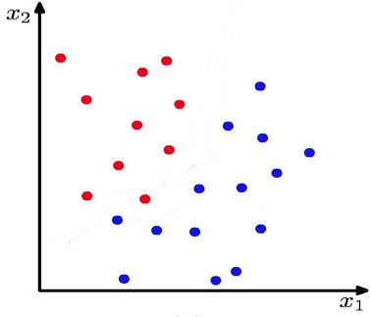
K Nearest Neighbour (kNN) Classifier
K = 1

Slide 38
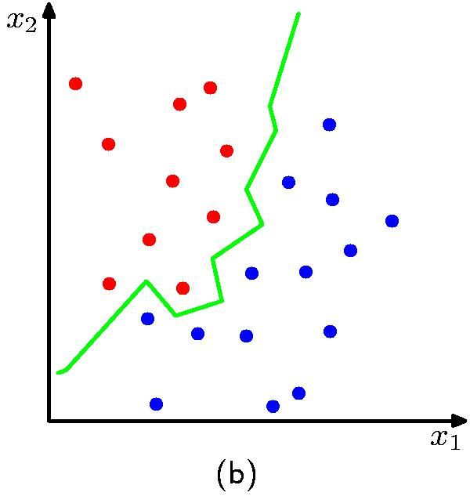
K Nearest Neighbour (kNN) Classifier
K = 1

Slide 39
Choosing k
What is the label with k = 1?
feature₂
label 1
label 2
label 3
feature₁

Slide 40
Choosing k
We’d choose red. Do you agree?
feature₂
label 1
label 2
label 3
feature₁

Slide 41
Choosing k
What is the label with k = 3?
feature₂
label 1
label 2
label 3
feature₁

Slide 42
Choosing k
We’d choose blue. Do you agree?
feature₂
label 1
label 2
label 3
feature₁

Slide 43
Choosing k
What is the label with k = 100?
feature₂
label 1
label 2
label 3
feature₁

Slide 44
Choosing k
We’d choose blue. Do you agree?
feature₂
label 1
label 2
label 3
feature₁

Slide 45
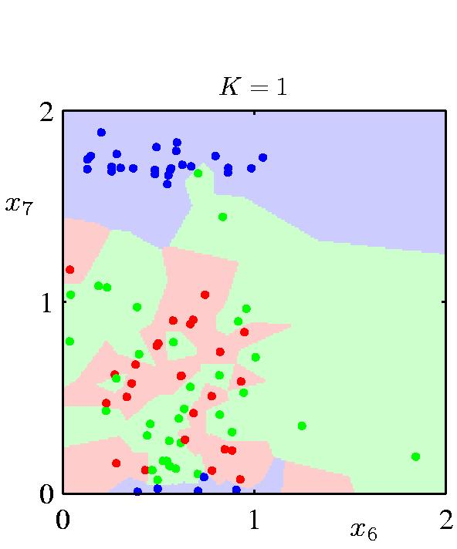
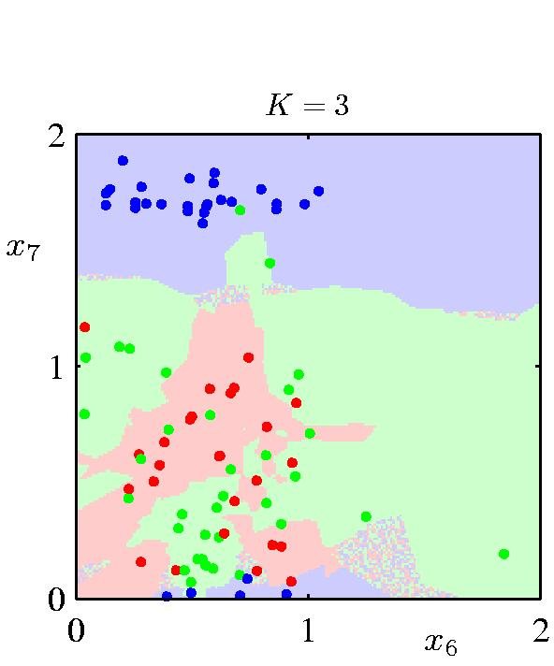
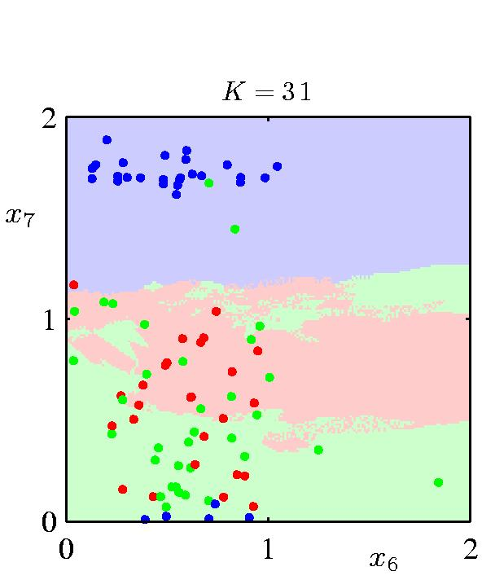
The impact of k
What is the role of k?
How does it relate to overfitting and underfitting?
How did we control this for decision trees?

Slide 46
k-Nearest Neighbor (k-NN)
To classify an example d:
Find k nearest neighbors of d
Choose as the class the majority class within the k nearest neighbors
How do we choose k?

Slide 47
How to pick k
Common heuristics:
often 3, 5, 7
choose an odd number to avoid ties
Use development data

Slide 48
k-NN variants
To classify an example d:
Find k nearest neighbors of d
Choose as the class the majority class within the k nearest neighbors
Any variation ideas?

Slide 49
k-NN variations
Instead of k nearest neighbors, count majority from all examples within a fixed distance
Weighted k-NN:
Right now, all examples within examples are treated equally
weight the “vote” of the examples, so that closer examples have more vote/weight
often use some sort of exponential decay

Slide 50
Decision boundaries for decision trees
label 1
label 2
label 3
What are the decision boundaries for decision trees like?

Slide 51
Decision boundaries for decision trees
label 1
label 2
label 3
Axis-aligned splits/cuts of the data

Slide 52
Decision boundaries for decision trees
label 1
label 2
label 3
What types of data sets will DT work poorly on?

Slide 53
Problems for DT

Slide 54
Decision trees vs. k-NN
Which is faster to train?
Which is faster to classify?
Do they use the features in the same way to label the examples?

Slide 55
Decision trees vs. k-NN
Which is faster to train?
k-NN doesn’t require any training!
Which is faster to classify?
For most data sets, decision trees
Do they use the features in the same way to label the examples?
k-NN treats all features equally! Decision trees “select” important features

Slide 56
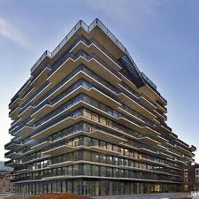
A thought experiment
What is a 100,000-dimensional space like?
You’re a 1-D creature, and you decide to buy a 2-unit apartment
2 rooms (very, skinny rooms)

Slide 57
Another thought experiment
What is a 100,000-dimensional space like?
Your job’s going well and you’re making good money. You upgrade to a 2-D apartment with 2-units per dimension
4 rooms (very, flat rooms)

Slide 58
Another thought experiment
What is a 100,000-dimensional space like?
You get promoted again and start having kids and decide to upgrade to another dimension.
Each time you add a dimension, the amount of space you have to work with goes up exponentially
8 rooms (very, normal rooms)

Slide 59
Another thought experiment
What is a 100,000-dimensional space like?
Larry Page steps down as CEO of google and they ask you if you’d like the job. You decide to upgrade to a 100,000 dimensional apartment.
How much room do you have? Can you have a big party?
2^{100,000} rooms (it’s very quiet and lonely…) = ~10³⁰ rooms per person if you invited everyone on the planet

Slide 60
The challenge
Our intuitions about space/distance don’t scale with dimensions!

Slide 61
Important to Watch Videos
A.I. Experiments: Visualizing High-Dimensional Space
https://www.youtube.com/watch?v=wvsE8jm1GzE
Neural Network 3D Simulation
https://www.youtube.com/watch?v=3JQ3hYko51Y

